Slide 1
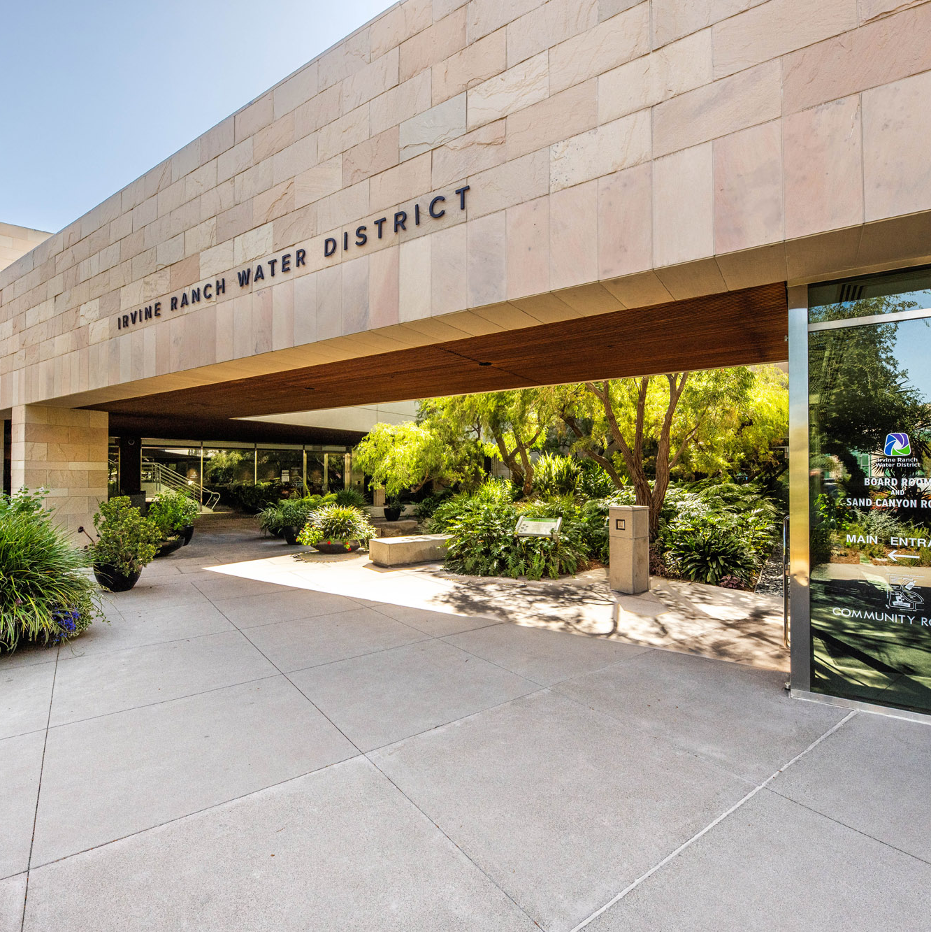

Outreach Luncheon
June 27, 2024
Notes:
Enter Month and Date

Slide 2


Slide 3
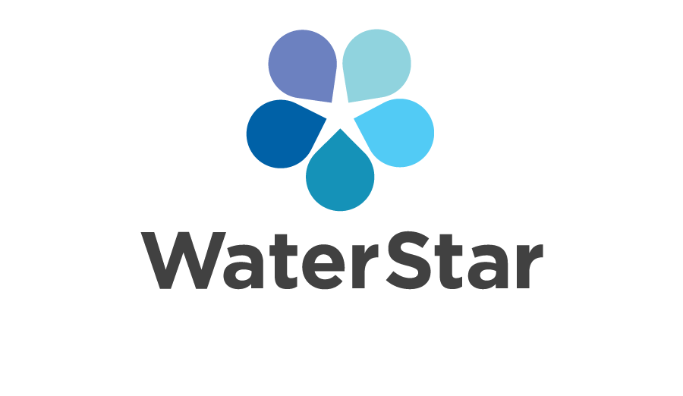
BUSINESS RECOGNITION PROGRAM

Slide 4
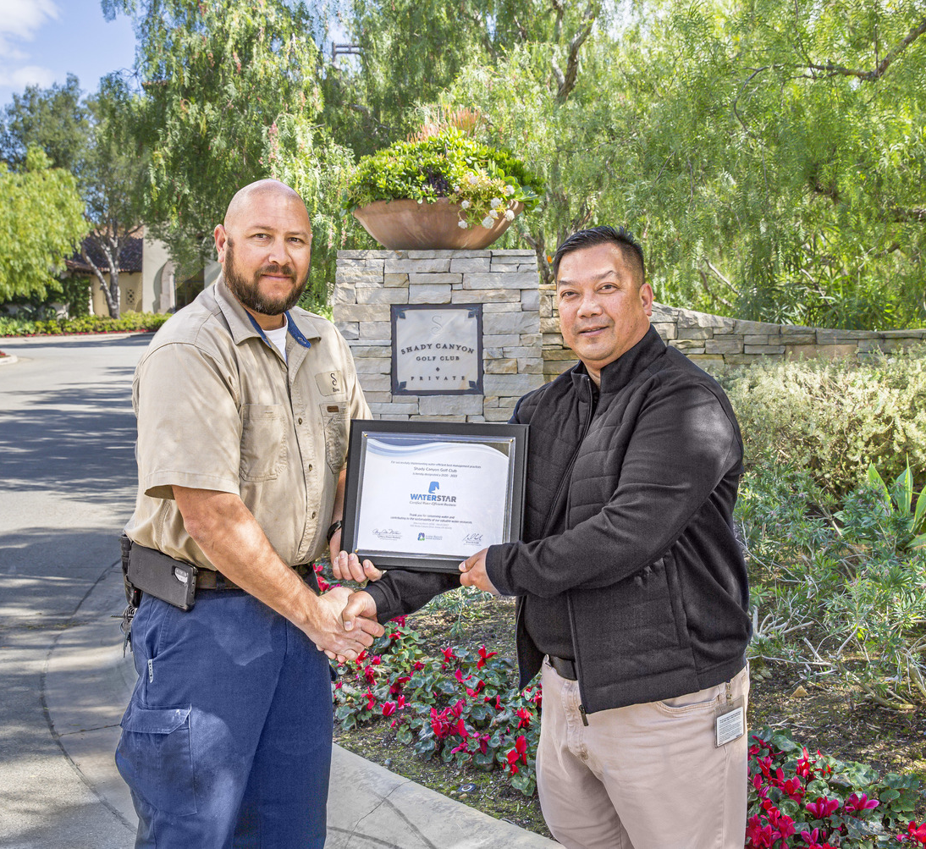
WaterStar Business Recognition Program
Recognizes water efficiency efforts of business and landscape customers
  WaterStar businesses featured on IRWD website and promoted through IRWD outreach materials
  Have use of WaterStar logo on their print materials and website
  First to know about new IRWD programs and incentives

Slide 5
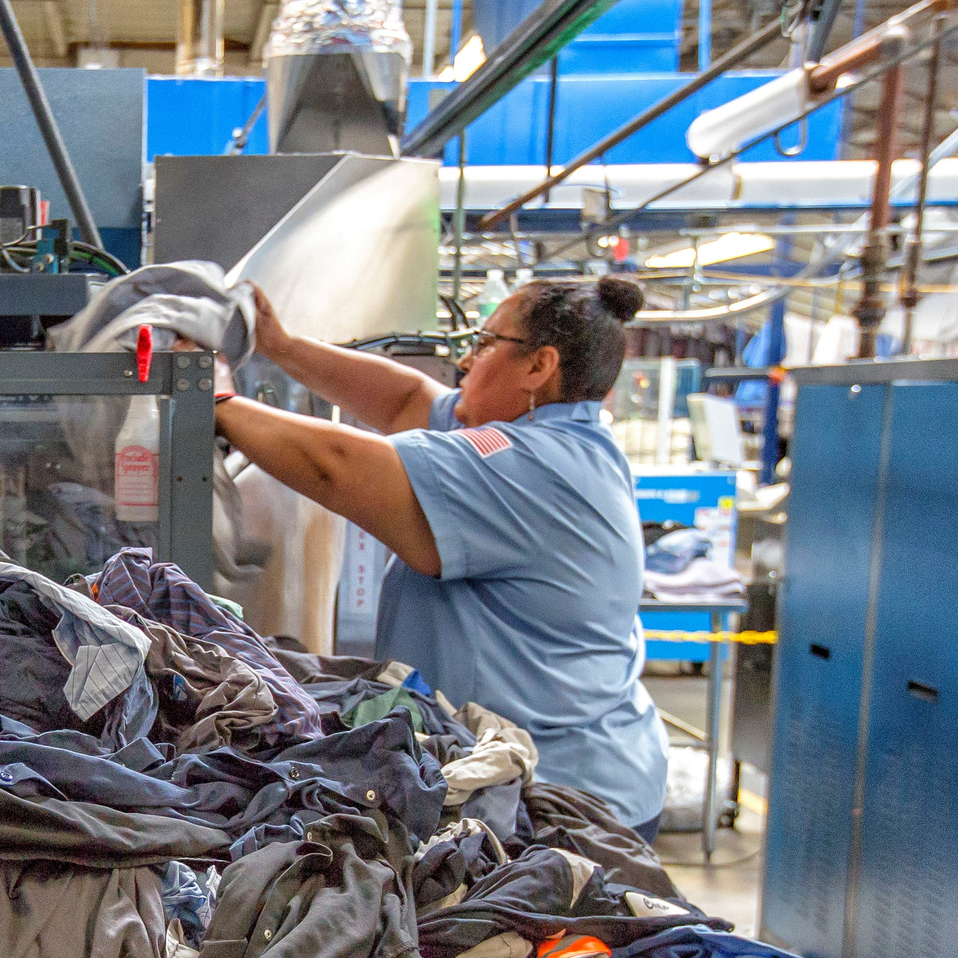
WaterStar Program Incentives
Rebates
  Plumbing fixtures
  Irrigation equipment
Free faucet aerators
Free site survey
Free water use reports
  Monitor trends
  Calculate savings
Notes:
For instance, Canon USA installed water-efficient faucets, toilets and shower heads. They use recycled water for outdoor irrigation. Canon’s commitment to water efficiency has resulted in saving more than 7 million gallons of water each year.
And that has saved them over $15,000 annually.

Slide 6
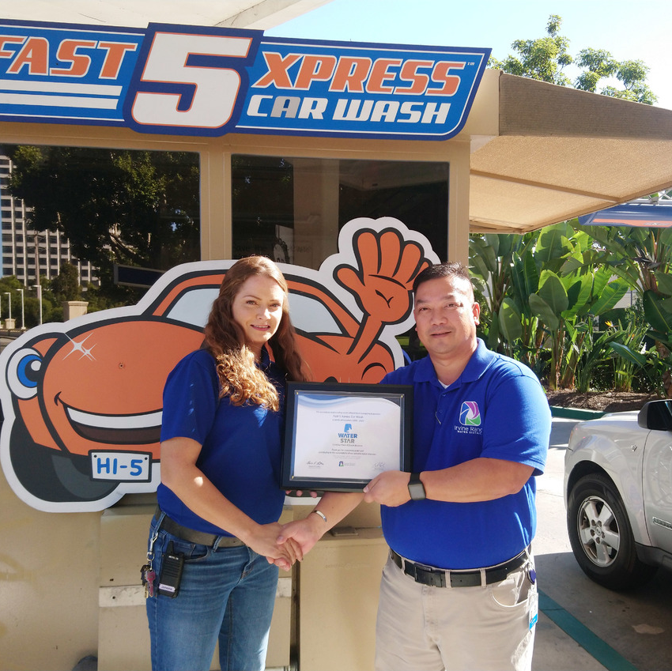
Eligible Businesses
Plumbing fixtures comply with California plumbing code
Process water use efficiency
Irrigation system complies with Model Water Efficient Landscape Ordinance
Use of recycled water

Slide 7
WaterStar Businesses
Saving more than 500 million gallons a year combined
Abbott
Bandai Namco
Canon USA
Capital Group
Chapman University
Checkered Flag Express Car Wash
Crean Lutheran High School
Fast 5Xpress Car Wash
Great Park Ice and 5 Point Arena
Hampton Inn
Hilton Garden Inn
Hoag Hospital
Hyatt House Irvine
Hyatt Regency Irvine
Imuraya USA
Karma Automotive
Kawasaki Motors USA
KIA Design Center
KIA Motors America
Masimo
Masimo Alton
Parker Meggitt
Prudential Overall Supply
Shady Canyon Golf Club
Shimano USA
Simpson Chevrolet of Irvine
Tierra Verde Industries
UC Irvine
2211 Michelson
Restaurants
BCD Tofu House
Between the Rinks
Cucina Enoteca
Notes:
Our most recent 5 water stars included in the list (highlighted)

Slide 8

Current & Upcoming Projects

Slide 9
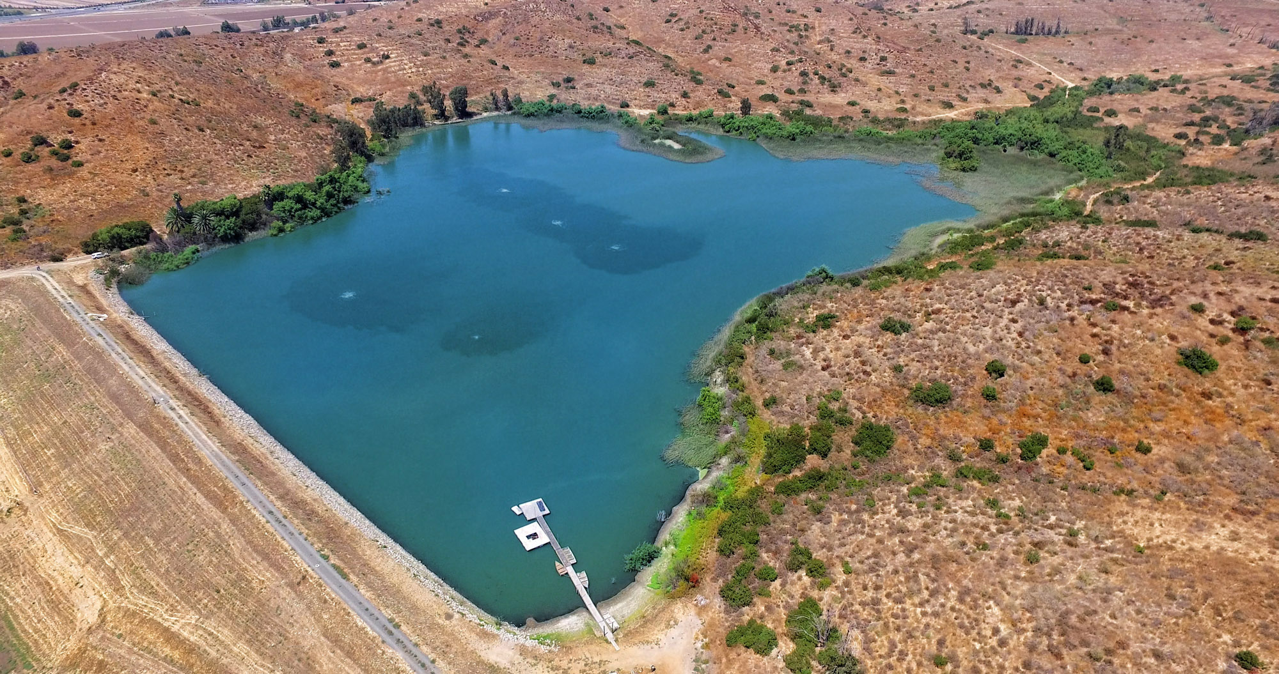

Engineering
Syphon Reservoir Improvement Project
Investment to increase capacity 10-fold
Allow IRWD to store more recycled water to meet seasonal and future needs
Make community more water resilient
syphonreservoirproject.com

Slide 10
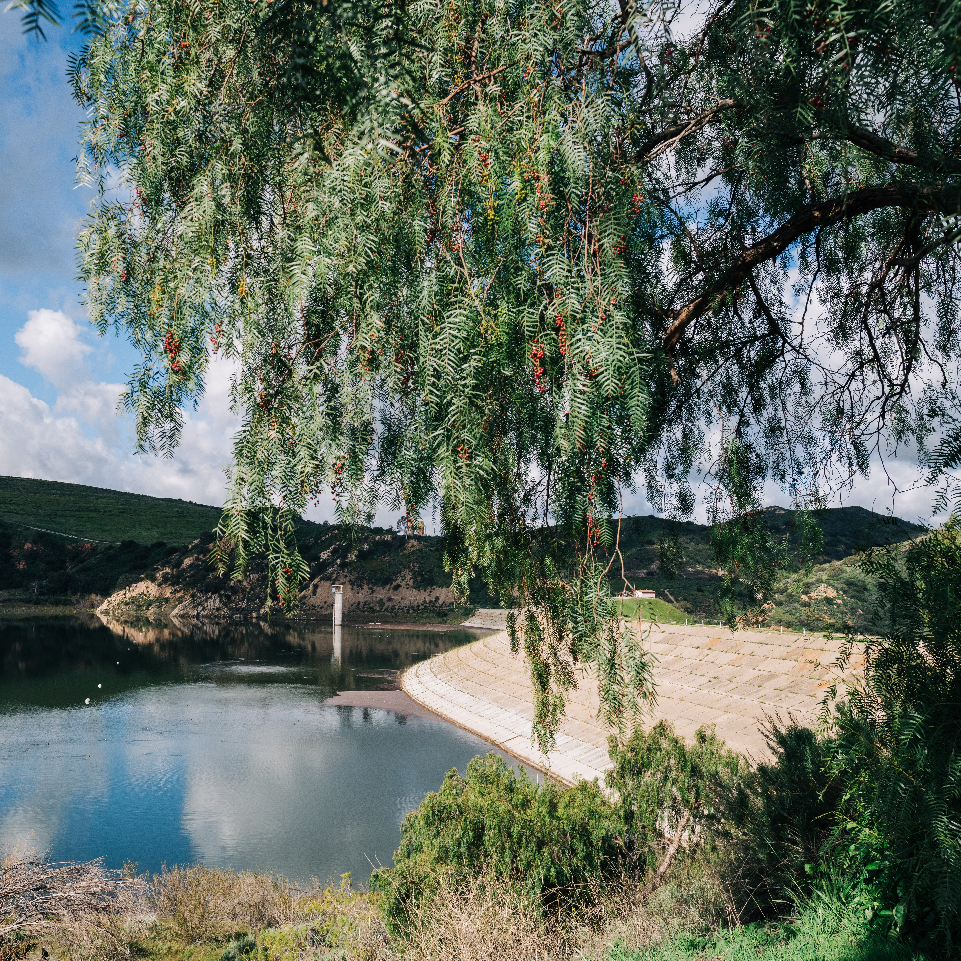

Engineering
Irvine Lake Improvement Project
Replace outlet tower and spillway at Santiago Creek Dam
Restore lake to full capacity
Overall safer facility that will increase reliability for years
irvinelakeproject.com

Slide 11
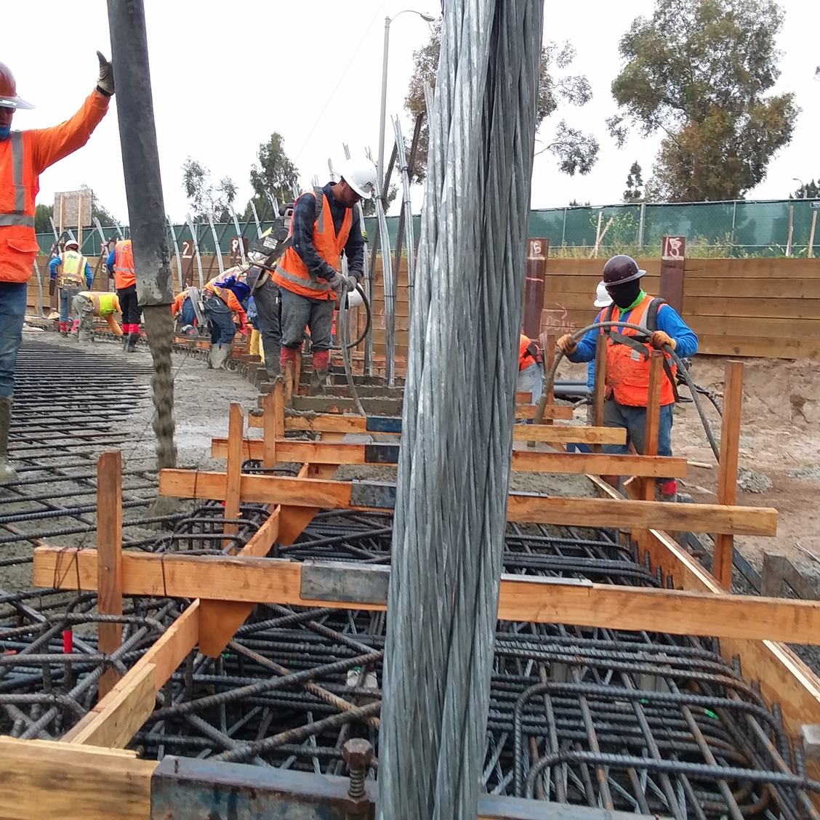
Engineering
Facility Rehabilitation and Replacement Projects:
Pump stations
Wellhead facilities
Water storage tanks
Miles of pipelines

Slide 12
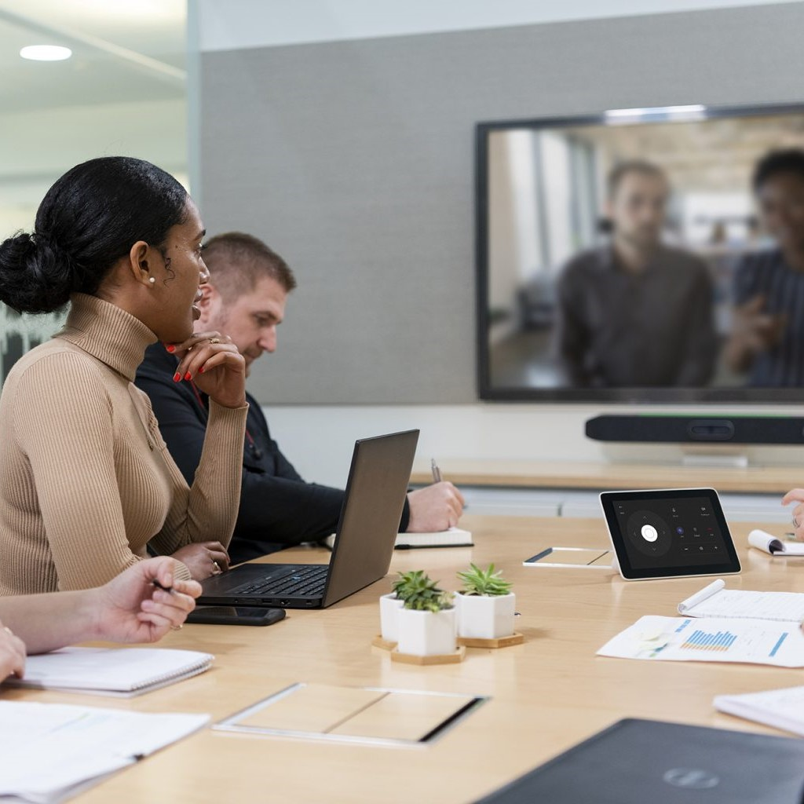
Finance
& administration
Banking depository services RFP
  Remote deposit
  Lockbox services
  Money market sweep vehicles for excess cash
ERP-CIS software selection RFP
  Consultant services to assist with selection of:
    Enterprise Resource Planning (Finance, Procurement, Human Resources)
    Customer Information System software

Slide 13

Finance
& Administration
Computer network redesign
  Network equipment & services to improve resilience, security, performance, mobility and integration
Enterprise applications support
  As-needed IT support for enterprise applications and to help with peak workloads
Cybersecurity improvements
  Various efforts to continuously improve cyber protection for the District

Slide 14
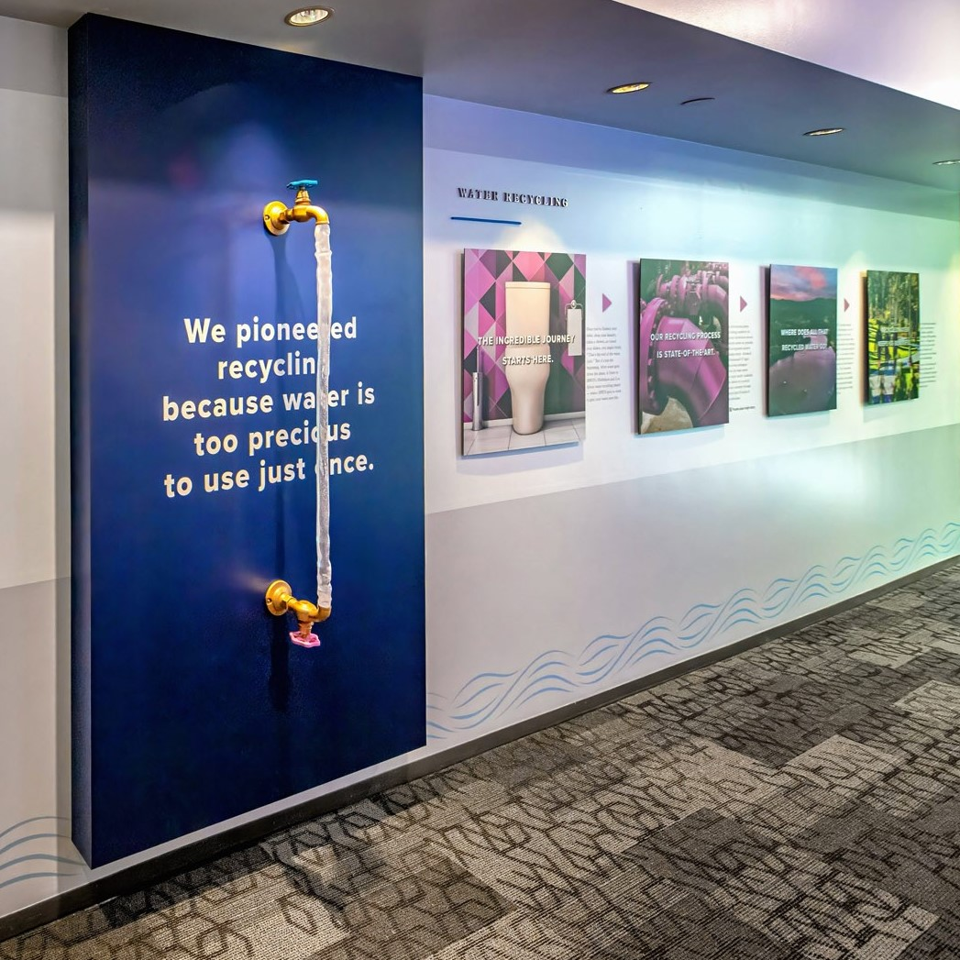
Communications
Website redesign
3-D educational displays and graphic wall wraps
Outdoor signs
Water-efficiency and water-quality outreach campaigns
Paid media: social, connected TV, video, streaming audio, etc.
Sustainable, branded promotional products

Slide 15

THANK YOU!
Get Connected

